Slide 1
Warm-up: Think-Pair-Share
On your graphic organizer: Work with a partner sitting next to you to come up with answers to the following questions:
In your own words, WHAT is the definition of history? (Answer on front)
WHY do we study history? (Answer on back)
WHO do we/should we study in history? (Answer on back)
Is history unchanging? Once something is written, does it or can it change? (Answer on back)

Slide 2
ESSENTIAL QUESTIONS
What is history?
Why do we study it?

Slide 3
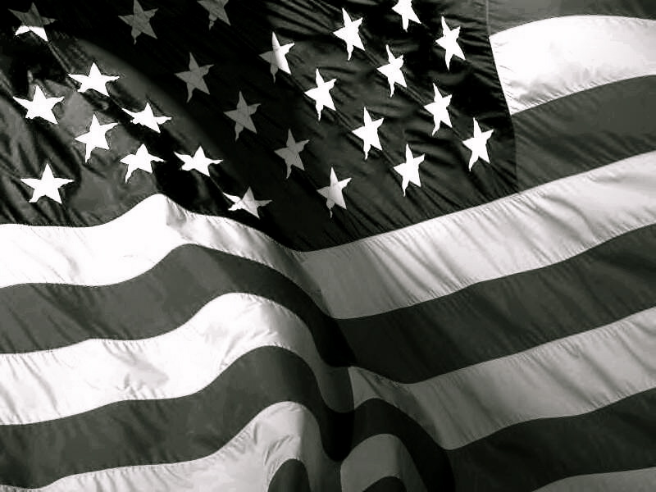
History… What/Why? EQ: What is history, and why do we study it?

Slide 4
What is History?
A chronological record of significant events (as affecting a nation or institution) often including an explanation of their causes
A study of the events of the past, how and why they happened, as well as what happened as a result
A branch of knowledge that records and explains past events
Which definition is your favorite?
Which one do you think is the most accurate?

Slide 5
Wait… isn’t this Social Studies?
A definition of social studies per merriam-webster.com:
“…a part of a school or college curriculum concerned with the study of social relationships and the functioning of society and usually made up of courses in history, government, economics, civics, sociology, geography, and anthropology”
In other words, a study of society! However, in Social Studies, History is the big brother to all the other sciences (Political Science, Econ., etc.).
So, we will have a blend of these sciences but for the purpose of studying let’s frame it under how we study History

Slide 6
WHY study history?
Why do you think we should study history?
Seriously…. Why care at all???
How do a bunch of dead, old people help us in our lives?

Slide 7
A short clip giving their take on the question:
https://www.youtube.com/watch?v=vgmNkYUL_Cw

Slide 8
WHY study history?
Why do you think we should study history?
“Those who are ignorant of the mistakes of the past are doomed to repeat them.”
Why not also study the SUCCESSES of the past and learn from them?
Do we need to know where we are from to help us figure out where we are going?
And, it’s FUN!

Slide 9
Think-Pair-Share
The Historical Record
With the same partner you had earlier, work together to answer this Essential Question (on the left side of your notebook):
How do we know what we know about history/the past when we were not there?

Slide 10
YOUR RESPONSES

Slide 11
How do we understand history?
Historians/Political Scientists, Social Scientists, etc. use the Scientific Method to address various questions….
Why was there an American Revolution?
Was it actually a “revolution”?
What caused the Great Depression?
Are Americans better off now than they were 30 years ago?

Slide 12
Scientific Process for historians
Ask a question
If tested and proven multiple times, becomes an established theory
Do background research
Either validated by peers or disproven
Form hypothesis
Publish results for other scientists to review
Test hypothesis (intensive research that examines all data or conducts experiment)
Confirm results and form conclusion

Slide 13
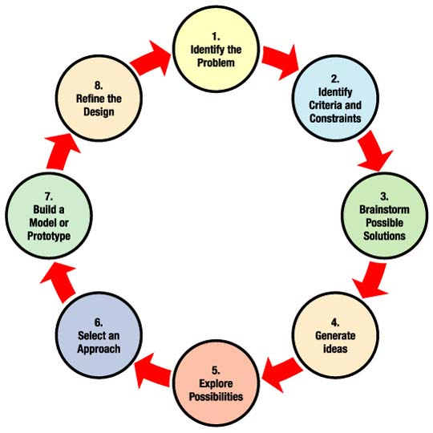
Look familiar?
Engineering design process

Slide 14
Okay, so how does a Historian do research and find “the truth?”
There are many pieces of evidence used to help Historians…

Slide 15
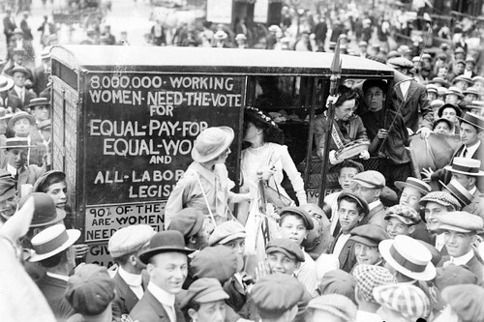
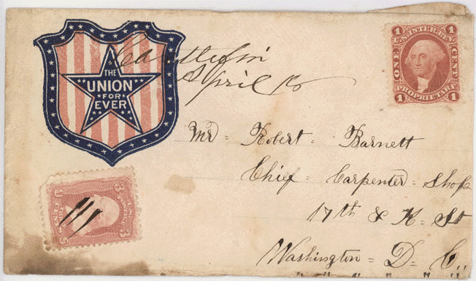
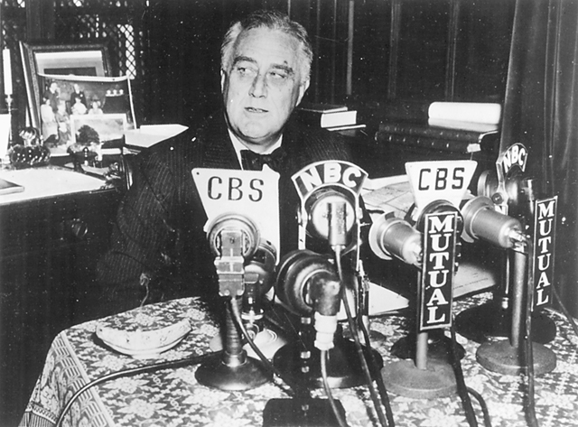
How do we know what we know about history when we were not there?
Written record – Letters, diaries, newspapers, books…
Oral record – Stories, music, speeches…
Visual record – Photographs, artwork, TV…
Artifacts – Things left behind (buildings, clothing, pottery…)

Slide 16
The written record

Slide 17
The Written Record
When studying history, we use PRIMARY SOURCES and SECONDARY SOURCES.
So… what are they? What do you think they are?
What is a source?
Why do we use sources?

Slide 18
Primary sources
A primary source is a document or physical object which was written or created during the time under study. These sources were present during an experience or time period and offer an inside view of a particular event.
Information from http://www.princeton.edu/~refdesk/primary2.html

Slide 19
Types of primary sources
Some types of primary sources include:
ORIGINAL DOCUMENTS (excerpts or translations acceptable): Diaries, speeches, manuscripts, letters, interviews, news film footage, autobiographies, official records
CREATIVE WORKS: Poetry, drama, novels, music, art
RELICS OR ARTIFACTS: Pottery, furniture, clothing, buildings

Slide 20
Examples of primary sources
Diary of Anne Frank - Experiences of a Jewish family during WWII
The Constitution of Canada - Canadian History
A journal article reporting NEW research or findings
Weavings and pottery - Native American history
Plato's Republic - Women in Ancient Greece
Can you think of any other primary sources?

Slide 21
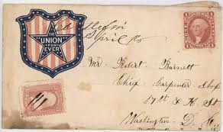
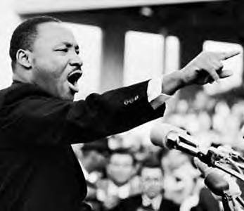
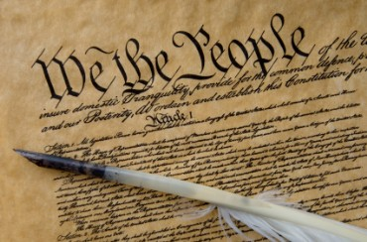
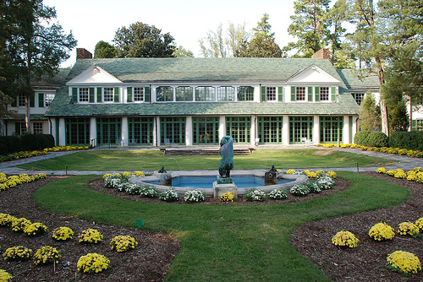
Primary sources

Slide 22
Secondary sources
A secondary source interprets and analyzes primary sources. These sources are one or more steps removed from the event. Secondary sources may have pictures, quotes or graphics of primary sources in them. Some types of secondary sources include:
PUBLICATIONS: Textbooks, magazine articles, histories, criticisms, commentaries, encyclopedias
Information from http://www.princeton.edu/~refdesk/primary2.html

Slide 23
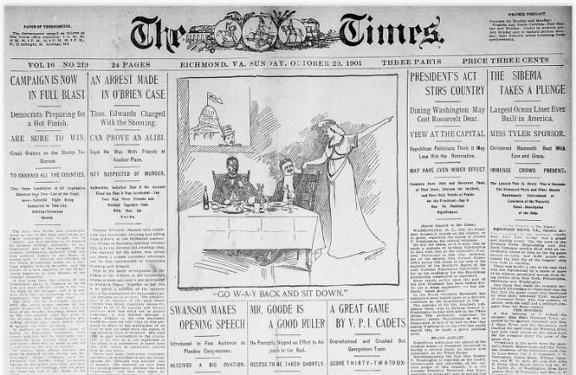
Examples of secondary sources
A journal/magazine article which interprets or reviews previous findings
A history textbook
A book about the effects of WWI
Can you think of any other secondary sources?

Slide 24
For sources, always ask yourself
What is the source?
When and where was it produced?
Who created it?
For whom was it created?
What was the creator’s intent?

Slide 25
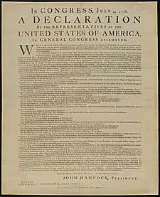
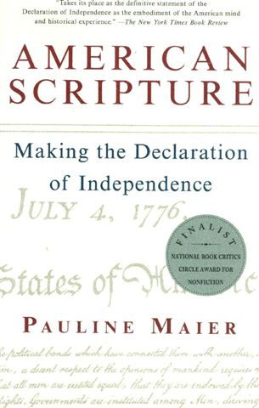
Primary vs. secondary sources
In groups of 3-4, discuss this question and come to an agreement on the question. Develop an argument supporting your response, and be prepared to share your answer with the class.
Is one type of source more valuable than the other? Why/why not?
VS.

Slide 26
The oral record

Slide 27
Oral record
The American Indians did not have a written record until the 1800s. How do we know about their lives and history before then? How did THEY know?
Are oral histories reliable? Why or why not?

Slide 28
Oral history today
Oral history very popular today, and many people are working to record people’s stories to preserve them for future generations.
Ellis Island Oral History - http://teacher.scholastic.com/activities/immigration/tour/stop2.htm
StoryCorps – A project from NPR designed to capture the stories of everyday Americans (not just politicians and other famous figures). http://storycorps.org/listen/

Slide 29
The visual record

Slide 30
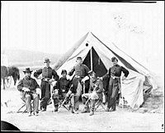
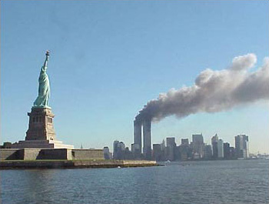
Visual sources
How can the visual record be helpful to us when we try to understand the past?
What types of visual sources can we use?
Photographs
Artwork
Video
Six officers of the 17th New York Battery – Gettyrsburg, PA June 1863
http://memory.loc.gov/ammem/cwphtml/tl1863.html

Slide 31
Visual Record

Slide 32
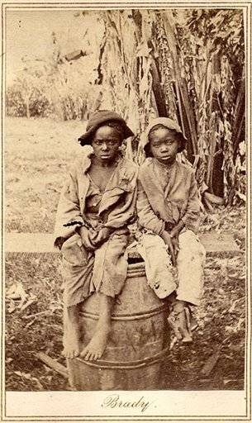
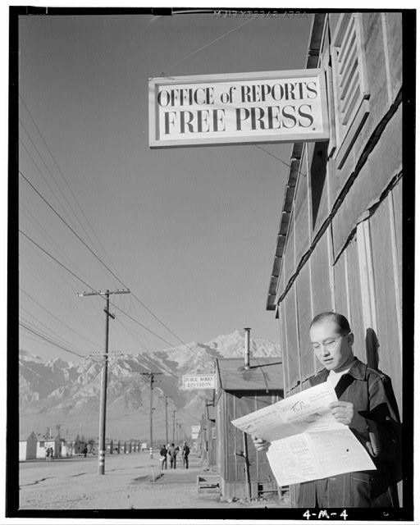
Visual Record

Slide 33
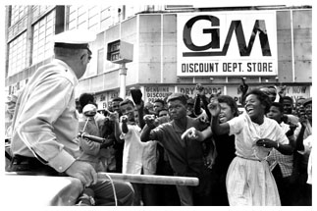
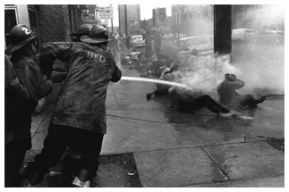
Visual record

Slide 34
The Artifact Record

Slide 35
Artifact record
What is an artifact? Put it in your own words.
For each of the following pictures, tell what you can conclude about the time in the past that is shown.

Slide 37
Artifact Record

Slide 38
Artifact Record

Slide 39
Artifact Record

Slide 40
Think/write a list of 5 things you did yesterday
1.
2.
3.
4.
5.

Slide 41
5 things you did yesterday
Did you leave a record of any of these?
Written, oral, visual, and/or artifact
How would future HISTORIANS know what you did?

Slide 42
3, 2, 1
What do you think are the 3 most important things to use in studying the past?
What are 2 warnings you need to give someone who is trying to “figure out” the past?
Answer this 1 important question: How do we know what we know about the past when we were not there?

Slide 43
Discuss the validity of this statement:
History is what we choose to remember about the past.
What about these questions…
What is bias? Does it exist in history?
Can we be sure that we actually KNOW what happened in the past?
How can we make sure that we are studying history as it actually happened, and not just how someone chose to write it?

Slide 44
What types of perspectives might we encounter in this class this year?
Where we are from, our parents’ background (politics: Conservative/Liberal), race, profession, information source bias, our hobbies, our other interests, prejudices, and of course ignorance of various ideas, peoples, etc.
Bias isn’t necessarily bad, but we must recognize bias as something that can distort our perception and keep us from seeing the whole range of views and pieces of evidence

Slide 45
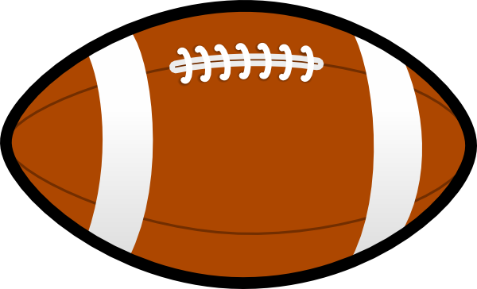
Bias and Point of View (POV)
What’s the difference?
Bias – generally has a negative context, prejudice
QUESTION: Which one is a football?

Slide 46
Point of View/Perspective
Generally has a neutral context
The way one considers an issue; mental attitude or opinion
Perspective can be built by examining:
Geography, Economics, Culture, Government, and Technology

Slide 47
There are different types of history
What kinds of history can you think of?
World
US
NC
WS
Hanes
Family
Social
Military
AND MANY MORE!

Slide 48
Importance of historical events
So, at some point you/historians have to JUDGE an event’s RELATIVE IMPORTANCE.
Let’s break it down.
What does relative mean?
What does importance mean?

Slide 49
EX: 2 armed nuclear bombs were accidentally dropped on Goldsboro, NC in 1961. Only 1 of 6 safety switches stopped the bomb from exploding.
Would this be more important to someone from Winston-Salem or New Orleans, Louisiana? WHY?
EX: Learning about strategic flanking battle maneuvers in World war II.
Who needs to know this more: an 8th grade student or a Lieutenant in the Army? Why?

Slide 50
What if we think of the events of this year so far?
What are some events that you think occurred are historically significant and have RELATIVE IMPORTANCE?
What about a non-important event?
Often, the importance of an event is not immediately known.

Slide 51
Point of View
A group of five people go for a walk: an artist, an engineer, a biologist, an athlete, and a real estate developer. They are out in the woods when they come upon a crystal-clear, flowing river. How do you think each of these people would view the river?
How does the previous scenario relate to our study of history and historians?

Slide 52
VOCABULARY REVIEW
HISTORY / HISTORIANS
ARTIFACT
WRITTEN RECORD
PRIMARY SOURCE
SECONDARY SOURCE
ORAL RECORD
VISUAL RECORD
RELATIVE IMPORTANCE
BIAS

Slide 53
Your FIRST HW
The BIAS Assignment
Handout
Due Friday!

Slide 54
TICKET OUT THE DOOR WRITE A SENTENCE (OR A FEW SENTENCES) USING AT LEAST 3 OF THE FOLLOWING WORDS ON A SCRAP PIECE OF PAPER:
Artifacts
Written Record
Bias
Historians
Relative Importance
Don’t forget to write your NAME, the DATE, and the CLASS PERIOD!

